Slide 1
Session 22
Feedback on Design Thinking Sessions – Registrations Insights
Presented by Clinton Naidu & Altonjunior Siima

Slide 2
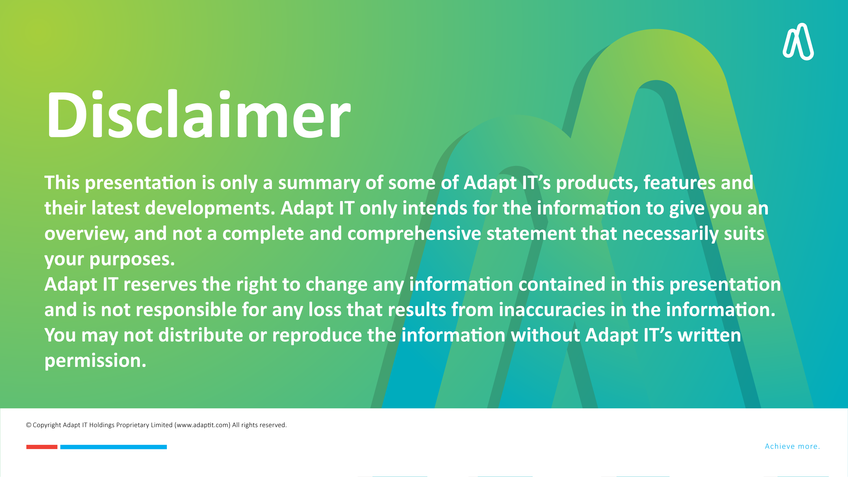
DISCLAIMER
This presentation is only a summary of some of Adapt IT’s products, features and their latest developments. Adapt IT only intends for the information to give you an overview, and not a complete and comprehensive statement that necessarily suits your purposes.
Adapt IT reserves the right to change any information contained in this presentation and is not responsible for any loss that results from inaccuracies in the information. You may not distribute or reproduce the information without Adapt IT’s written permission.

Slide 3

What are Insights?
Benefits of Insights
Design Thinking Workshops
Registrations Pain Points Feedback
Monitor Registrations
Registrations Trends
Subsidy & Targets
Subsidy (CESM)
Registration Insights Designs
Your Thoughts & Comments
Table of contents

Slide 4
What are Insights?

Slide 5
What are Insights
Understandings or revelations that emerge from analyzing data, experiences, or observations.

Slide 6
Benefits of Insights

Slide 7
Benefits of Insights
Enhanced Innovation
Informed Decision-Making
Increased Efficiency
Better Customer Understanding
Competitive Advantage
Improved Problem Solving
Increased Adaptability

Slide 8
Design Thinking Workshops

Slide 9
Design Thinking Workshops
22
218
46
Client Engagement Sessions
Client Participants
Internal DT Sessions
Registrations

Slide 10
Registrations Pain Points Feedback

Slide 11
Registrations Pain Points Feedback

Slide 12
Monitor Registrations

Slide 13
Monitor Registrations
Institutional Target
1st time Entrants
Qualification Targets
Late Applications
Registration Period
Near Real Time

Slide 14
Registrations Trends

Slide 15
Registrations Trends
5 years
Applications vs Admissions vs Registrations
FTEN
National vs International

Slide 16
Subsidy & Targets

Slide 17
Subsidy & Targets
CESM
1st Time Entrants
Forecast
Scarce Skills
Notes:
Open CESM to floor
2% calculation

Slide 18
Subsidy (CESM)

Slide 19
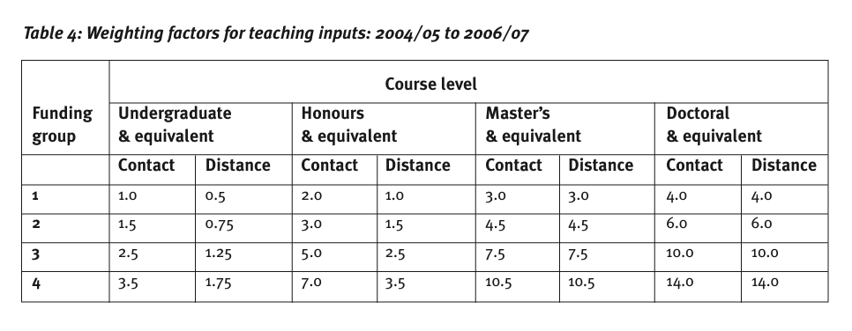
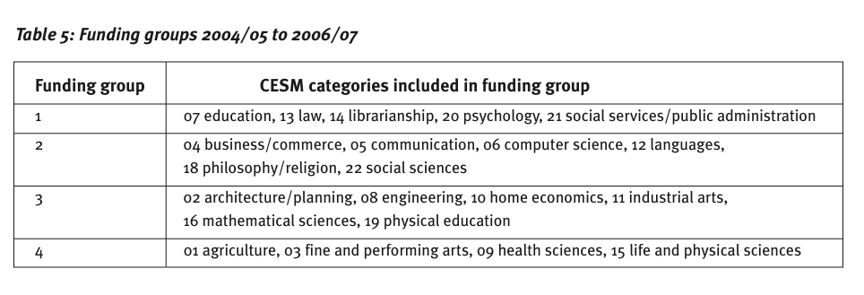
Subsidy (CESM)
https://www.dhet.gov.za/Publications/Public%20funding%20of%20Higher%20Education%20in%20South%20Africa.pdf
Notes:
Open CESM to floor
2% calculation

Slide 20
Registration Insights Designs

Slide 21
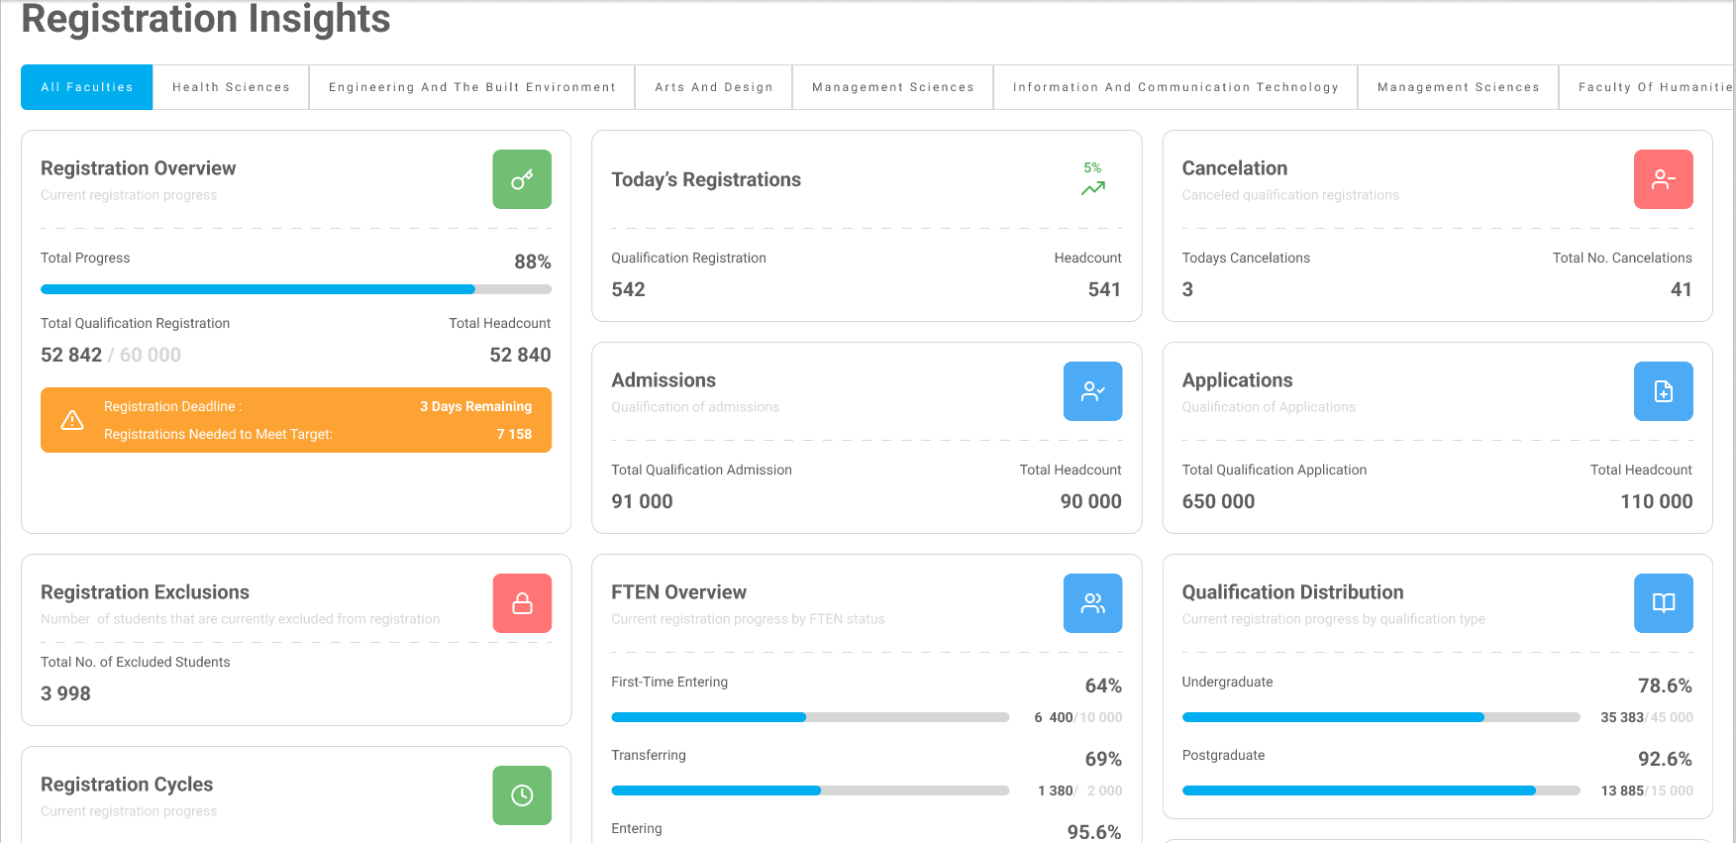
Registration Insights Designs

Slide 22
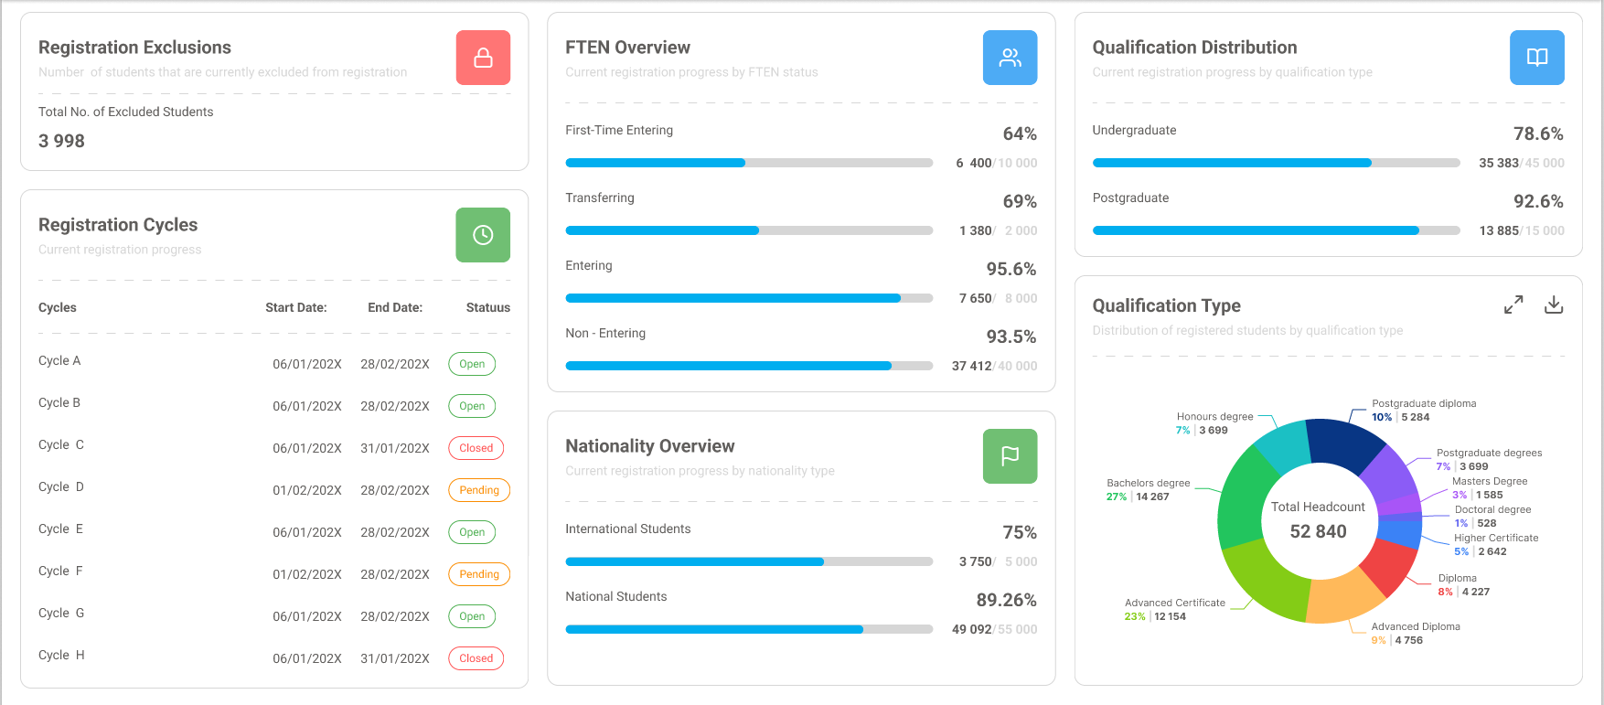
Registration Insights Designs

Slide 23
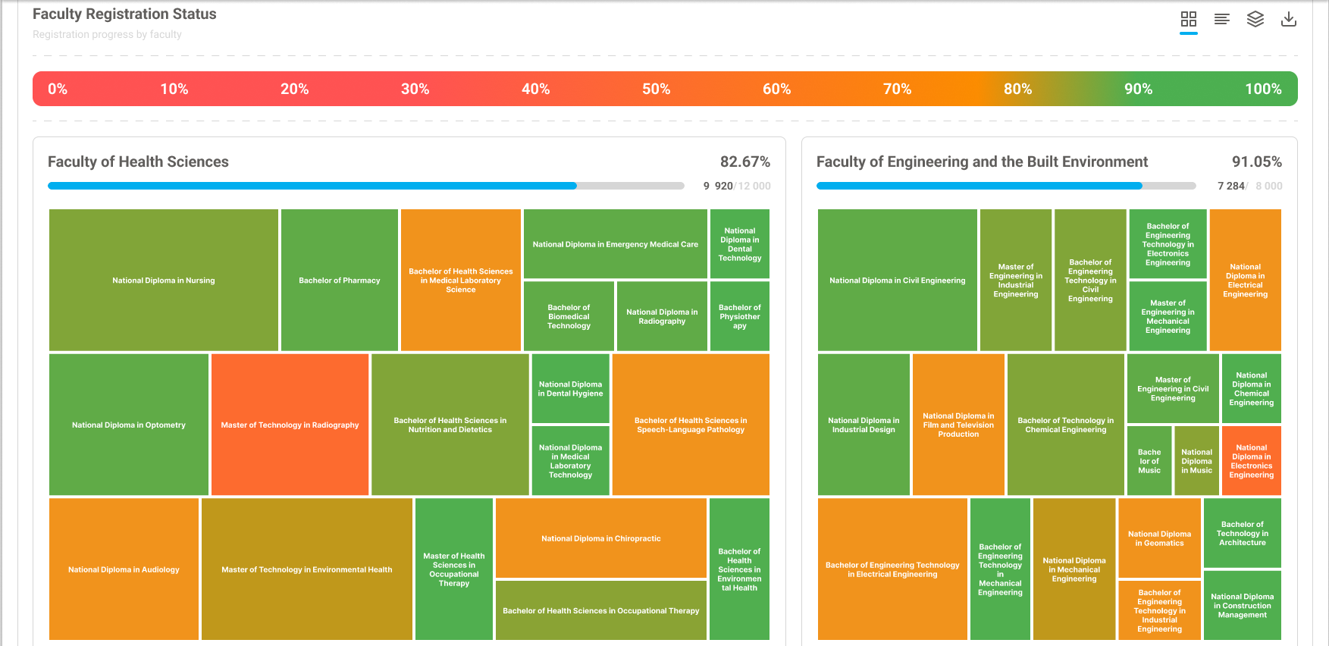
Registration Insights Designs

Slide 24
Your Thoughts & Comments

Slide 25



